Slide 1
Group Aware MSI Protocol
Chingyi Lin, Chunke Tan

Slide 2
Outline
Motivation
Group Coherence State
Interconnection network
Evaluation
Conclusion

Slide 3
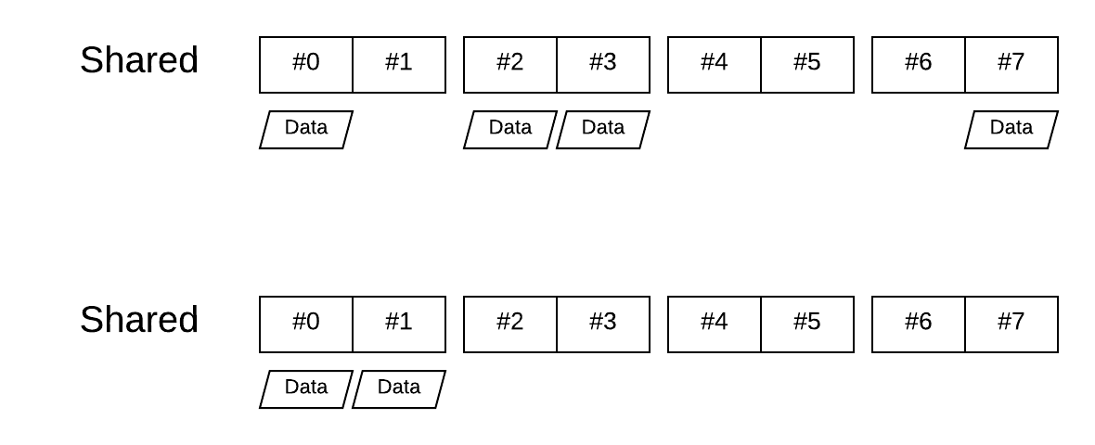
Motivation
Cache coherence is not necessary to be held in global.
This project targets on multi-threaded program with only a subset of processor. In these cases, we hope detailed cache coherence state will improve the performance.
Notes:
More result

Slide 4
Group Coherence State
 | Normal | G
Invalid | I | GI
Shared | S | GS
Modified | M
The flag “G” means the coherence is only held
inside the group. Or this G- flag implies cacheline
outside the group are all invalid
Invalid state (I): Data is invalid
Group-invalid state (GI): Data is invalid, but it must be held by its neighbor or lower-level.
Shared state (S): Data is shared
Group-shared state (GS): Data is shared. Non-neighbors are all invalid.
(Group-) modified state: Modified state implies that every other is invalid.

Slide 5
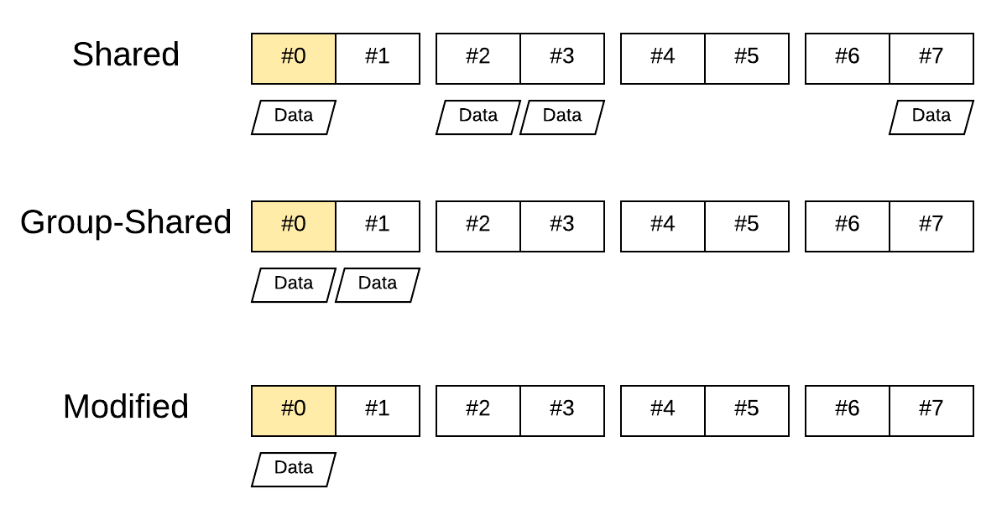
Group Coherence State
Note
Group-shared is a subset of shared state
Without G-flag, the program
still works, but more inefficient

Slide 6
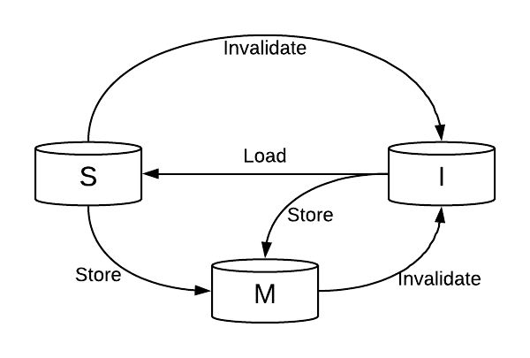
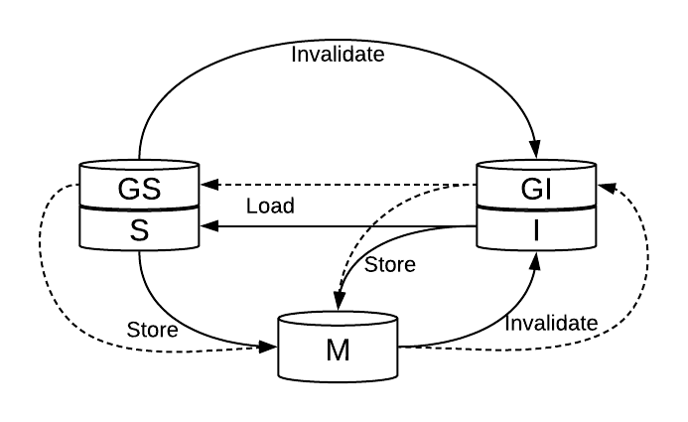
Group Coherence State
The state transition is expanded. But the behavior of group-state is similar to the original.
The G- flag will be given with “Reduce” request from directory, and be removed by “Expand” request.

Slide 7
Group Coherence State
 | Normal | G
Invalid | I
Shared | S
Modified | M
Special case #1: All processors are in a group
(nIntras = nCore)
Group- flag can be skipped
  “G-” flag means “proc outside the group” are invalid -> Trivial
Only three states: Modified, (G-)Shared, (G-)Invalid
This is equivalent to MSI protocol

Slide 8
Group Coherence State
 | Normal | G
Invalid | I
Shared | S | E
Modified | M
Special case #2: Each processor is in a single group
(nIntras = 1)
Modified
(Group-) Invalid: G- flag doesn’t affect the behavior
Group-shared = Exclusive state in MESI protocol
Shared
This is equivalent to MESI protocol

Slide 9
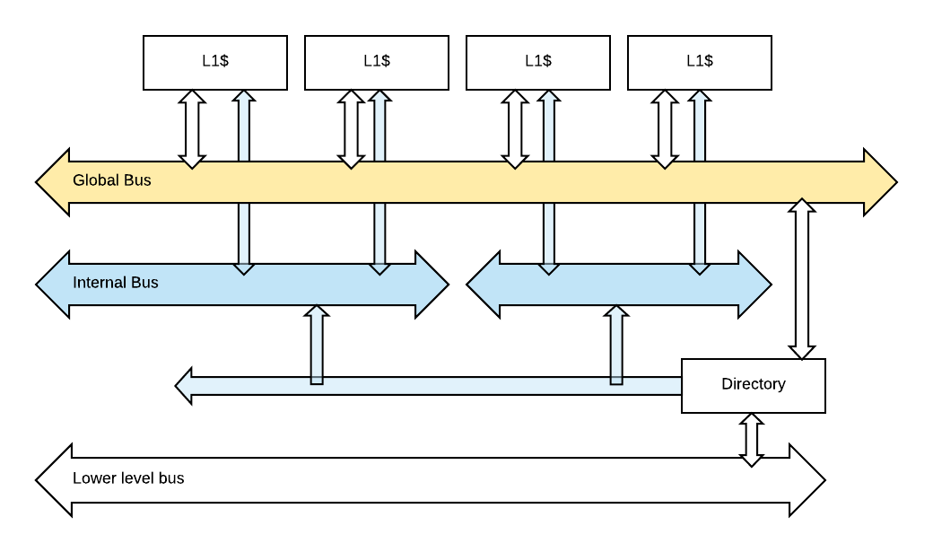
Interconnection network
There are two kinds of bus adhered to L1$
Global bus
  Every L1$ can transmit to another L1$
Internal bus
  Can only transmit to its neighbor
Directory
  L1$ -> Directory: Through global bus
  Directory -> L1$: Depends

Slide 10
Evaluation
Parameter
nCore: # of total core on the system
nThread: # of thread of the program
nIntra: # of processor in a group
  nIntra=1,2,4 … Fix-number group
  nIntra=ncore, ncore/2 … Dynamic group
Bus configuration
Transmission time = 2 * nIntra

Slide 11
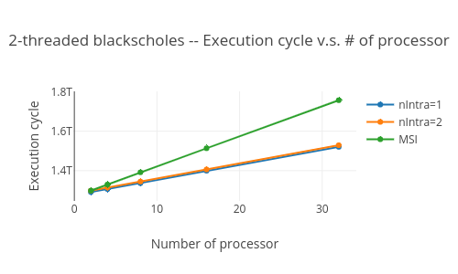
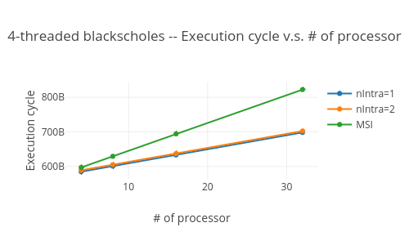
Evaluation
Execution time v.s. # of processor

Slide 12
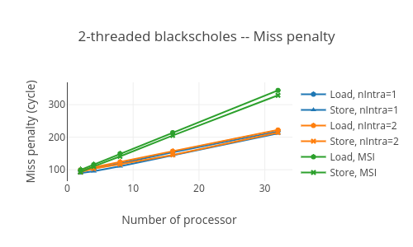
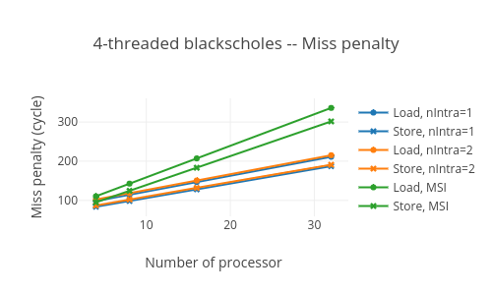
Evaluation
Miss penalty

Slide 13
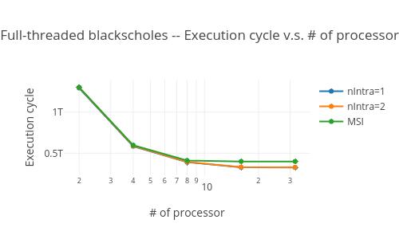
Evaluation
Full-thread program
nThread = nCore

Slide 14
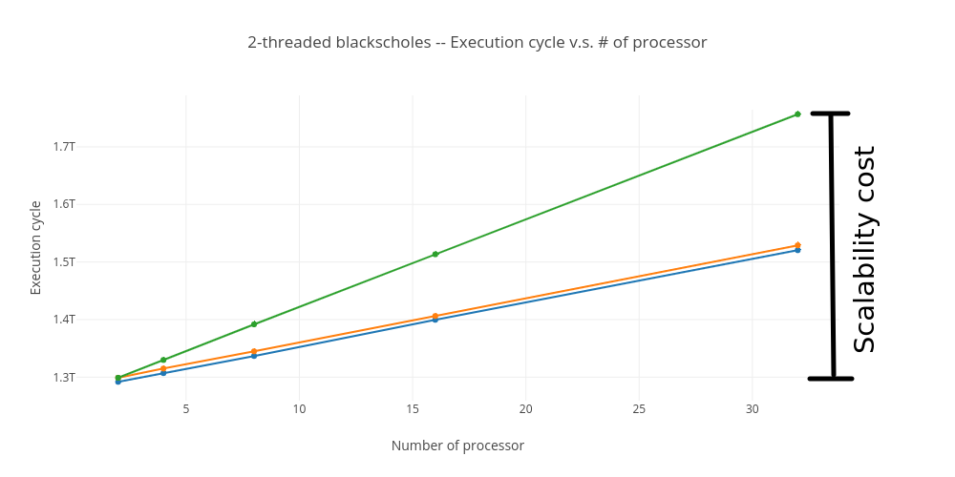
Conclusion
The additional internal bus can decrease the miss penalty
Fix-numbered group saves half of scalability cost
G-flag works !!!

Slide 15
Questions?

Slide 16
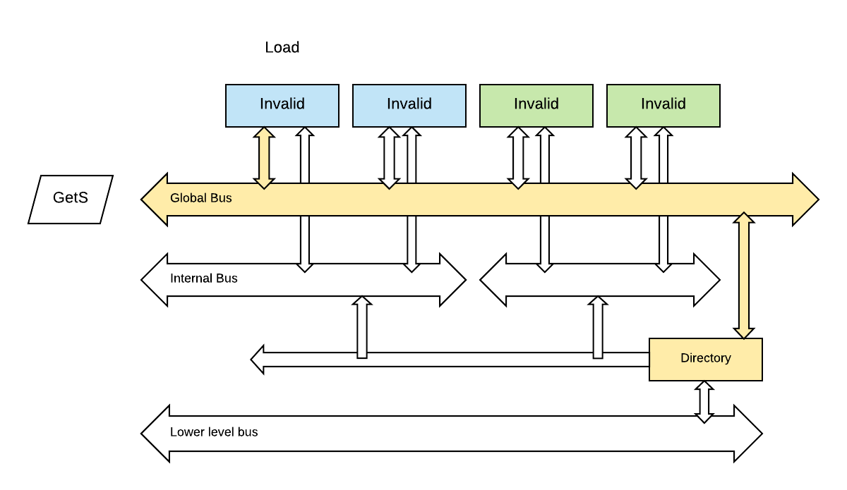
Example -- Ask an M permission
Step (1/6): Proc #0 issue a load
GetS through global bus
  From L1$ to directory

Slide 17
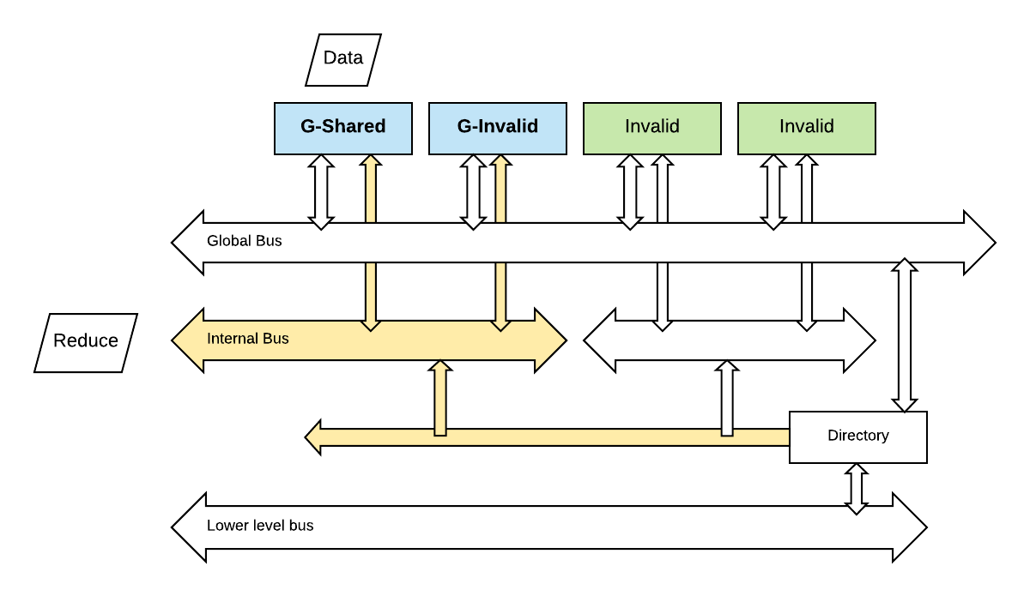
Example -- Ask an M permission
Step (2/6): Group with proc #0 is reduced
No one has the data. So directory will send a “Reduce” request to procs in the group with proc #0
Proc #0: Shared -> G-Shared
Proc #1: Invalid -> G-Invalid

Slide 18
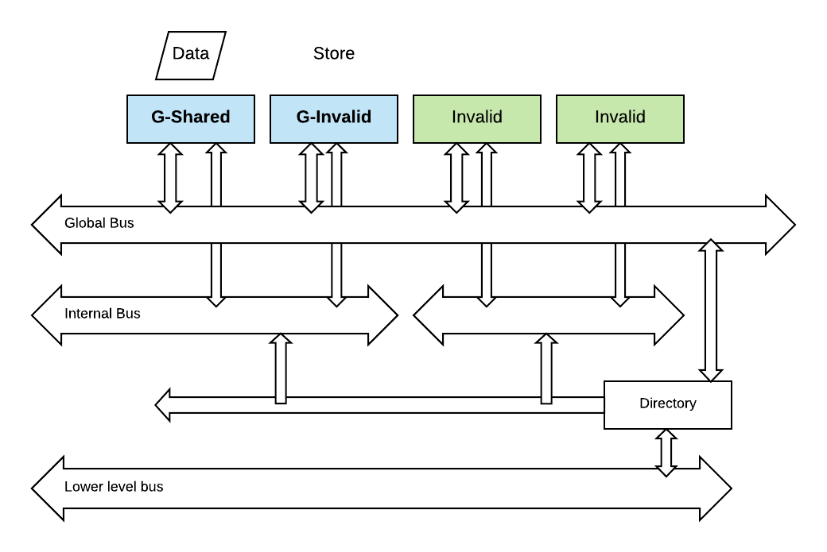
Example -- Ask an M permission
Step (3/6): Load from proc #0 is complete.
Proc #1 issues a store

Slide 19
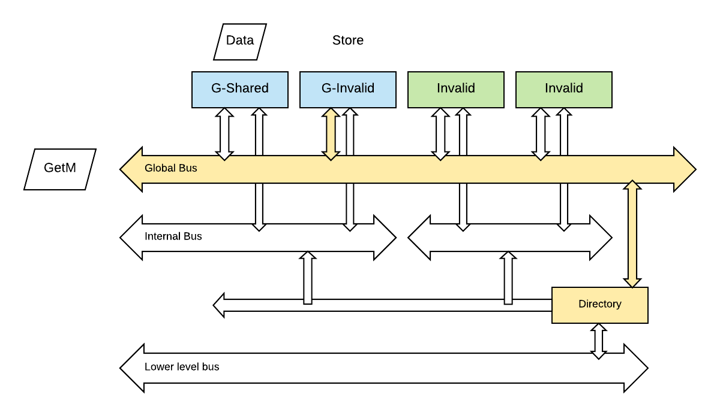
Example -- Ask an M permission
Step (4/6): Proc #1 issues a store
GetM through global bus
  From L1$ to directory
  With G- flag

Slide 20
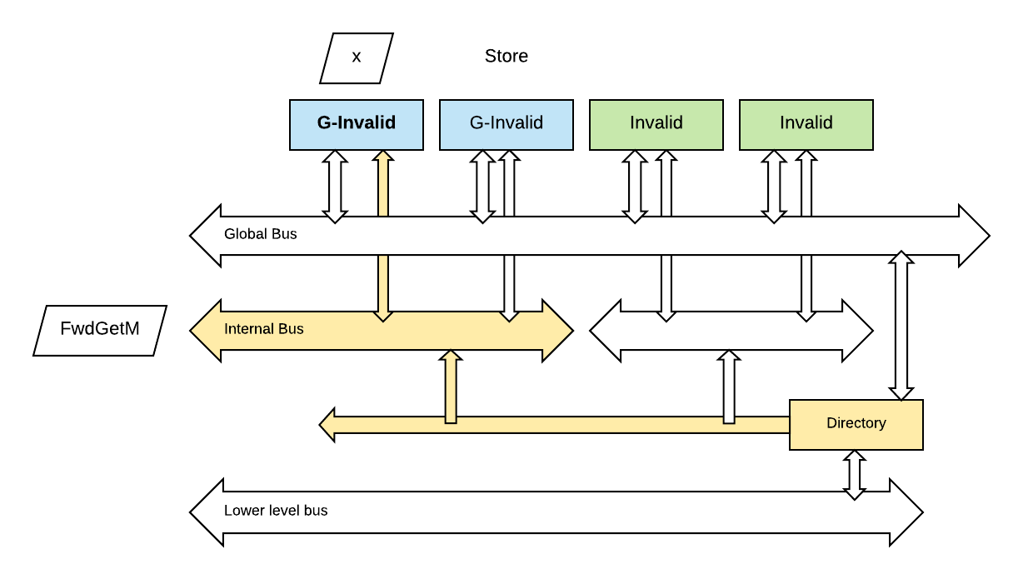
Example -- Ask an M permission
Step (5/6): Forward this GetM to data sharers
The request is with G- flag
  Don’t care inter-proc
Forward GetM through internal bus

Slide 21
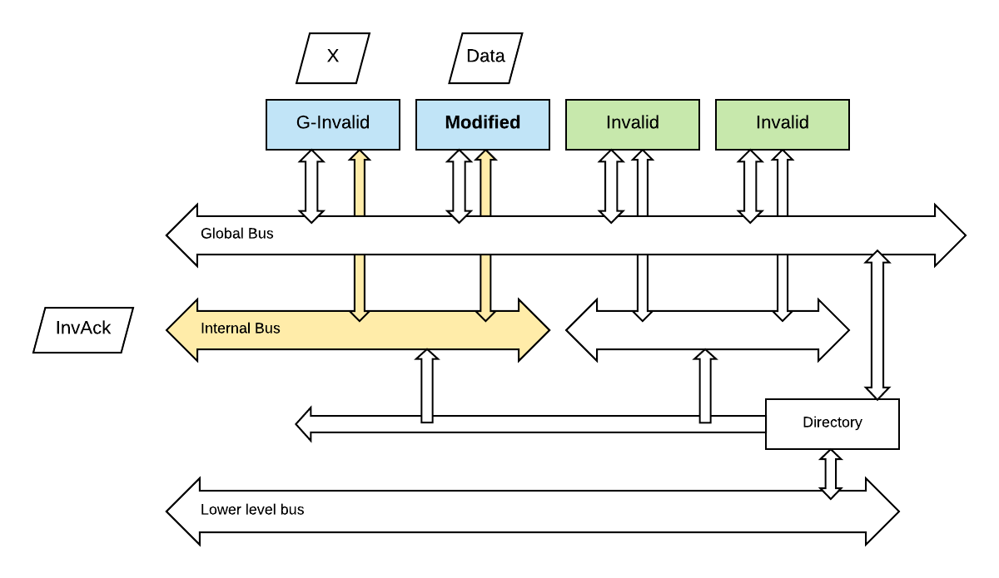
Example -- Ask an M permission
Step (6/6): Send InvAck to requestor
Proc #0 send back Ack after it invalidates the cache line.
The $-state is with G-flag
  Requestor must be in the same group
Proc #1 goes to Modified

Slide 22
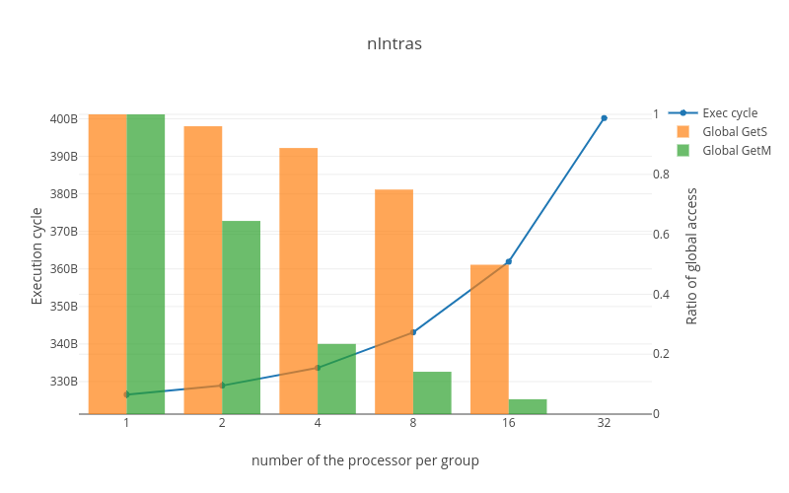
How nIntras affects?

